Slide 1

Cross Selling Recommendation
Erwin Linares
10/2/2023

Slide 2

Agenda
Problem Statement
Approach
EDA Summary
Recommendations

Slide 3
Problem Statement
XYZ Credit Union in Latin America is performing very well in selling bank products however there is one slight problem they are having little success attempting to cross sell there products to existing customers.
XYZ Credit Union is looking to implement a machine learning algorithm to increase cross selling, but my job is to figure out whether machine learning is required or not through analyzing the data.

Slide 4
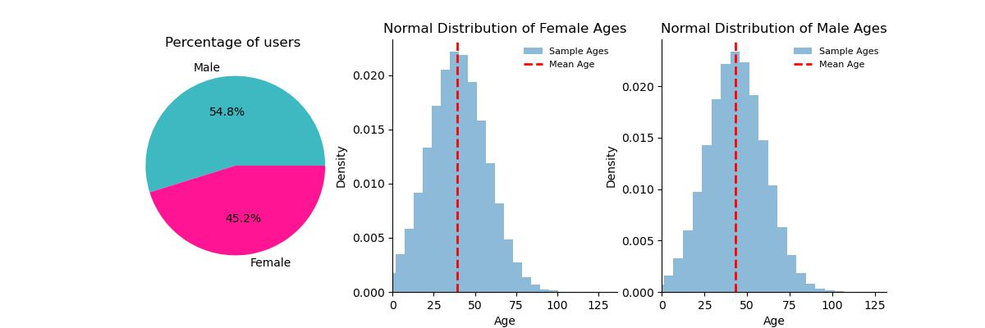
Customer Demographics

Slide 5
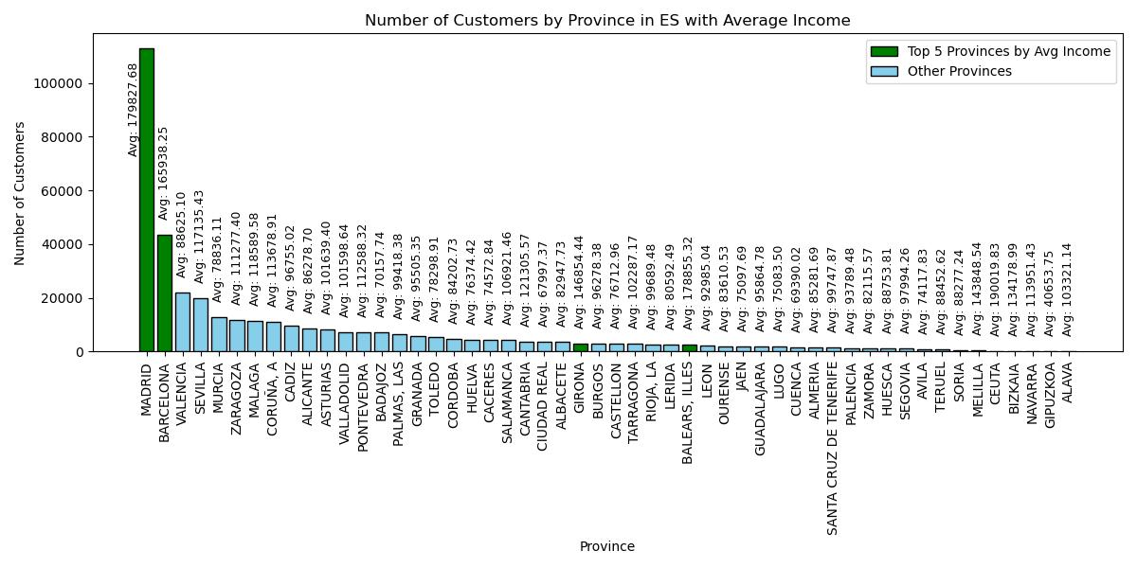
Province Customer Distribution

Slide 6
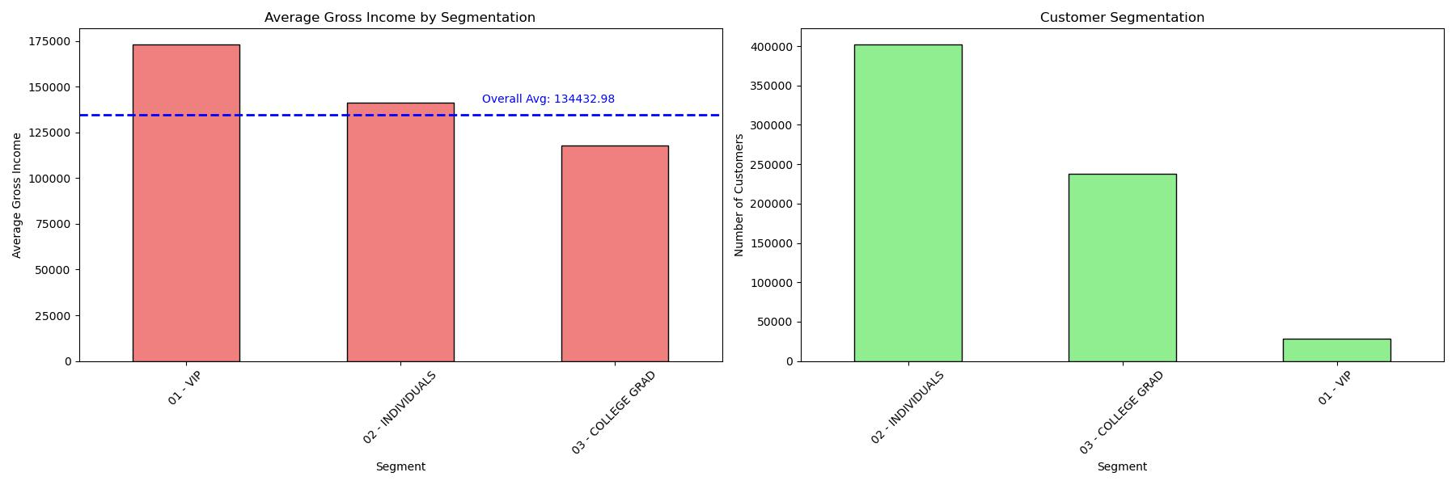
Segmentation Distribution

Slide 7
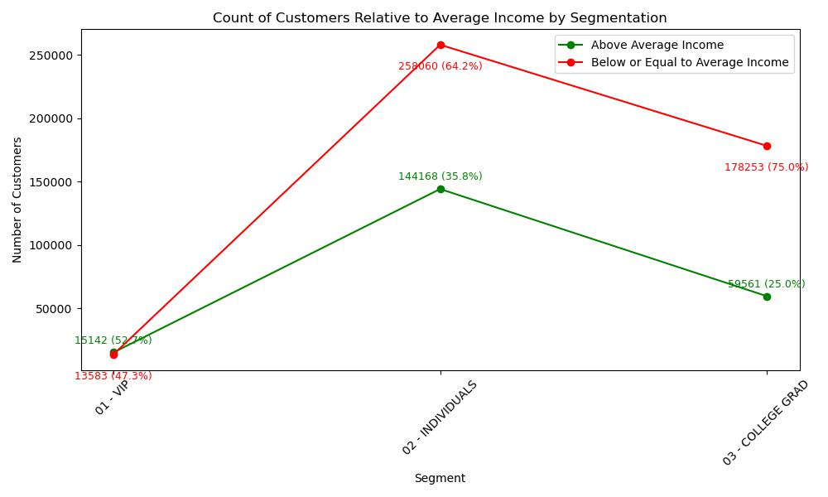
Segmentation Distribution

Slide 8
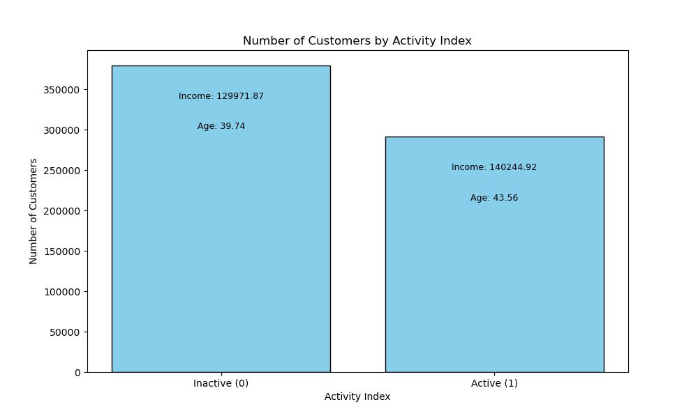
Activity Distribution

Slide 9
Final Thoughts & Recommendation
Going through and analyzing this data set I would like it to be known that I only looked over the test data set and did not look over the data set as a whole as it seemed 900k records with 24 attributes would be sufficient enough for analysis assuming that the test and training data set were split without bias.
During my analysis columns were changed and attributes data types were also changed along with the dropping of null values.
Within the test data set it was evident that there was a grand difference from minimum and maximum values of customers gross income.
My analysis however drove me to the conclusion that the bank is most likely better off targeting audience who live in either madrid or Barcelona, who are around middle ages of 40, who are either “VIP” or “Individuals” , and finally when targeting customers they should reach out to the inactive customers and get them more active once again by offering them special offers and for those active customers offer them continued loyalty specialties with each new service to continue to have their business. Targeting this demographic and understanding how advertisements/ coupons could be targeted to is essential for the credit union.

Slide 10
Thank You

